Slide 1
Control Theory
Part Two: Drive Slew and PID Controllers

Slide 2
Recap
Define:
Pose
Error
Controller
Open-Loop and Closed-Loop controllers
What is Slew?
Why do we want a closed-loop controller for VEX?
What should we try to do when naming variables? (from day one)
What’s a rate limiter?
BONUS: When would we use an open-loop controller?

Slide 3
BONUS
We very briefly covered this… can anyone tell me how to find the names of functions available to you?
Hint: It’s a website, and it’s in the menu bar at the top under one of the categories!

Slide 4
Drive Slew
How To Make a Smoother Drive By Implementing Slew

Slide 5
Why would we implement slew in our drive code?

Slide 6
The Code
Yesterday, we made a slew function that takes in three parameters: current, target, and slew step. We then put it into our closed-loop controller to prevent it suddenly starting and stopping.
Today, we’ll continue by implementing slew in our drive code!
What we need to do:
Save our current speed since we need it for our slew function
Find our target speed (the value of our joysticks)
Pick a slew step
Apply slew to our output

Slide 7
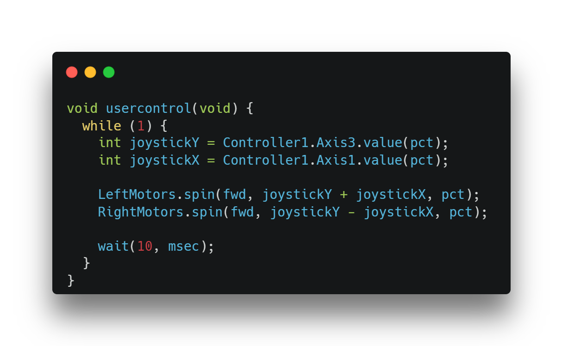
The Code – Saving Our Speed
Our slew function takes in a parameter called “current”. Since we’re using our slew on our motor speed, we need a way to know what our current motor speed is.
Challenge: How would I modify this code to keep track of our current speed?
HINT: Speed is just the value of the joysticks that gets sent to the motors!

Slide 8
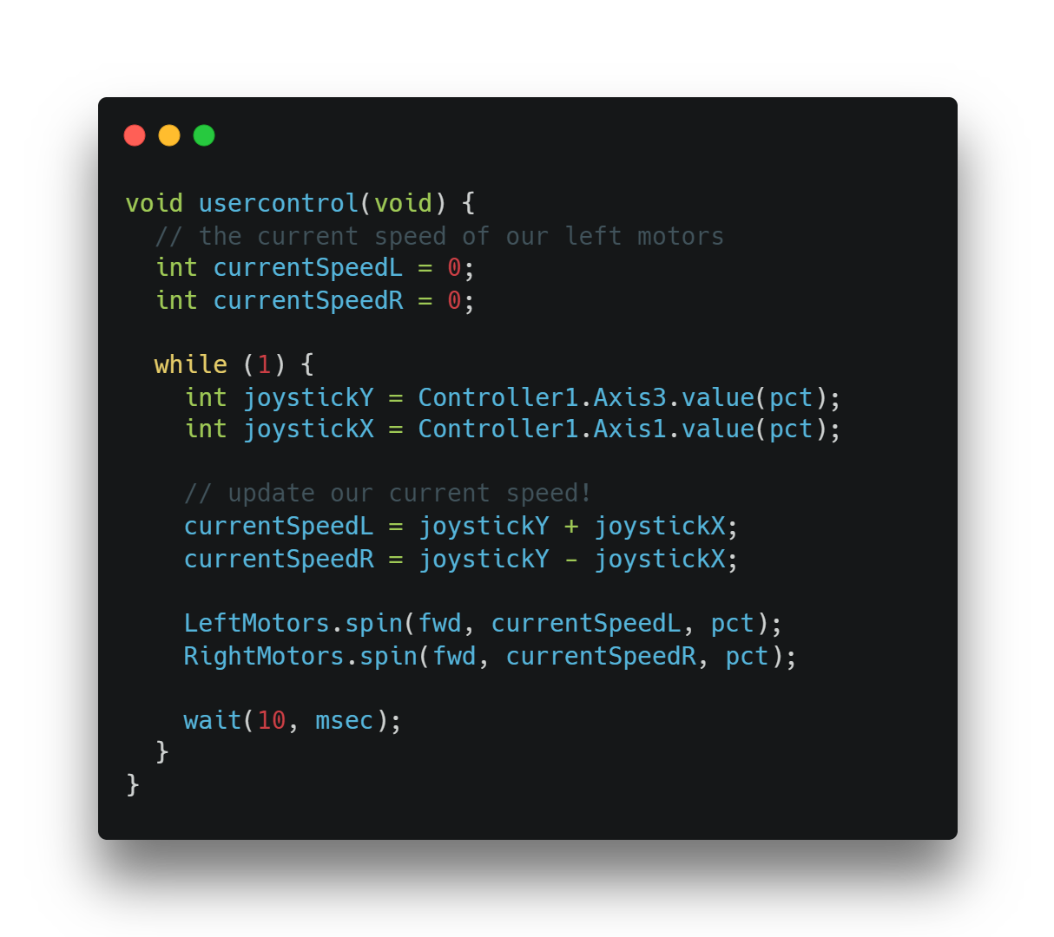
The Code – Saving Our Speed
With that, we’ve successfully done part one of our slew function. We now have our current speed!

Slide 9
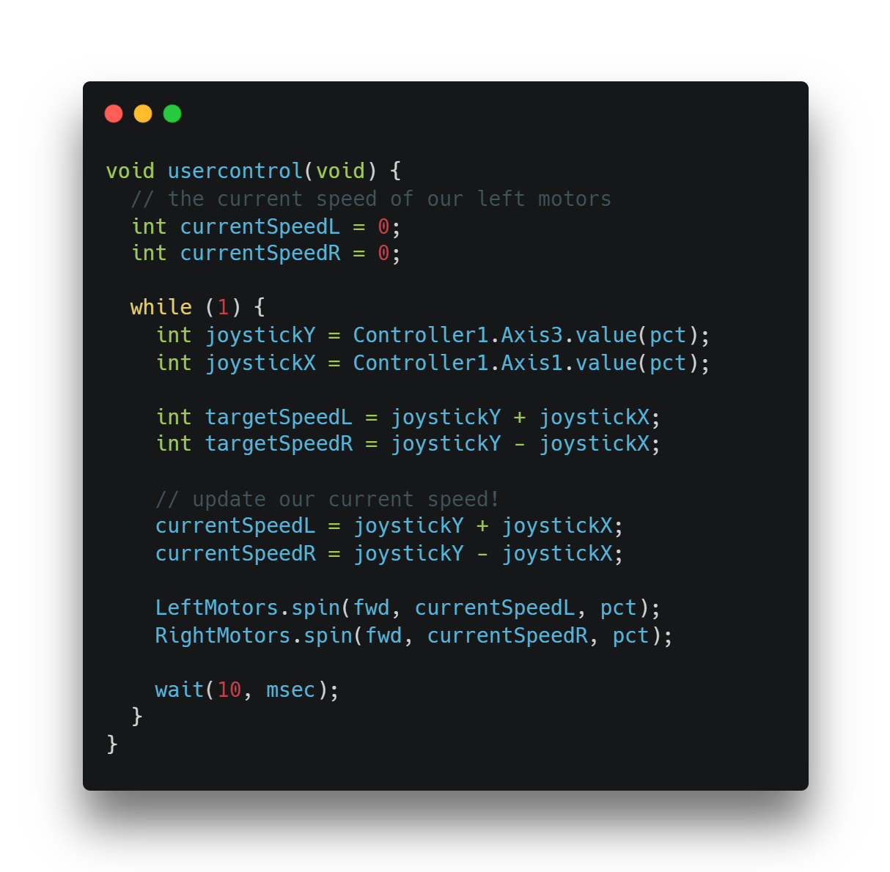
The Code – Getting Target Speed
Once we know our current motor speed, we need to get our target speed. What gives us our target speed in this code?
Answer: Our joystick values!
Now, let’s make some variables for our left and right target speeds. For now, they’re the same as current speed. Why?

Slide 10

Picking a Slew Step
How do we know what slew step to use?
We don’t!
Quick, everyone tell me your favorite food.
Much like your favorite food, there isn’t one perfect option all the time. When we’re picking a slew step, we should pick something that feels right to us.
When we produce a rough estimate, we should consider two things:
How big could our value be?
How fast do we need to change?
Your turn: pick a value you think would be correct. Whoever gets closest to the value I’m thinking of wins a piece of candy. (my value is a reasonable value you might use).

Slide 11
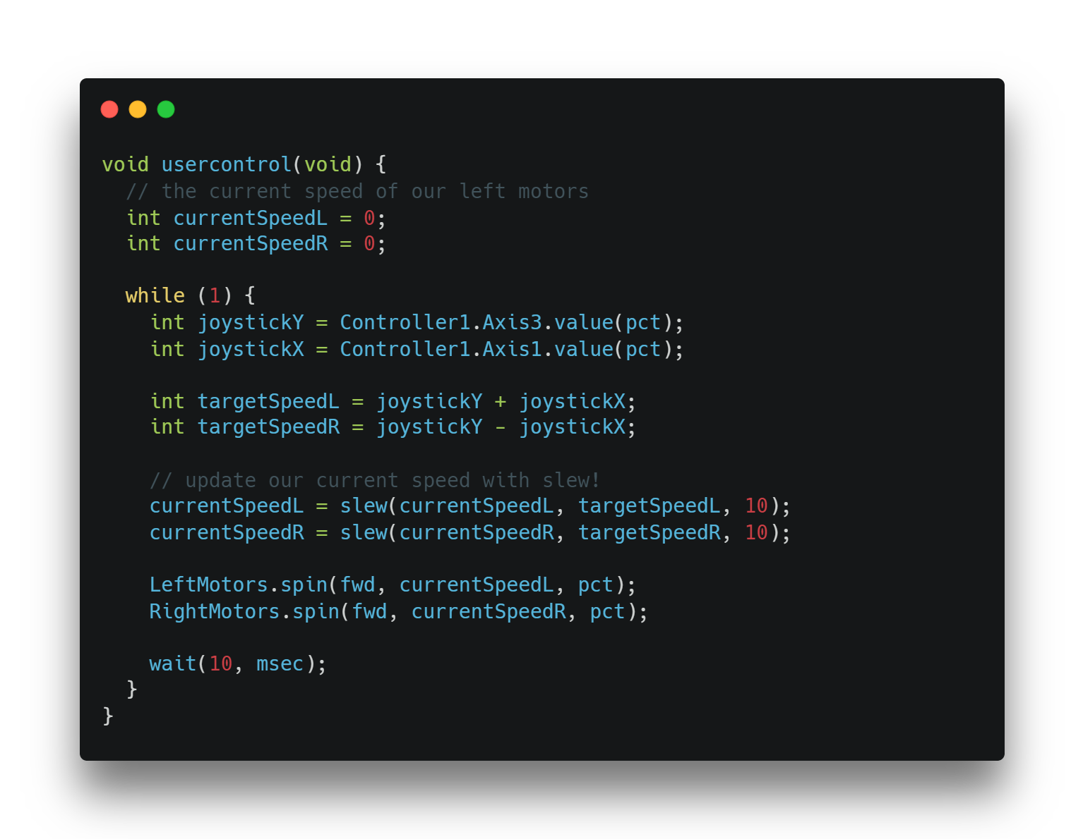
The Code – Slewing The Value
We have our current speed, our target speed, and our slew step. All that’s left now is to use them in our drive code to call our slew function.
HINT: Our slew function works by taking in three values, then spitting out the new correct value.
I’ll give five minutes for everyone to try this on their own, and then I’ll go over it.

Slide 12
Testing Slew
Try slew on my chassis! Press ‘A’ to turn on slew, and ‘B’ to turn it off.
Note: It might seem better without slew at first, but it will be better once weight is added.

Slide 14

PID Controllers
A closed-loop controller that NASA uses to steer rockets and a number guessing game, now in your local VEX robot.

Slide 15
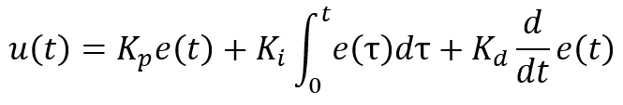
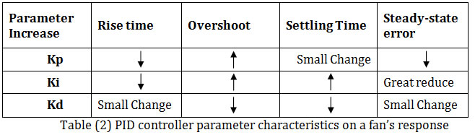
Understanding PID
PID stands for Proportional, Integral, Derivative. It’s a closed-loop controller that uses “gains” to turn and move your robot around accurately. Your robot already uses it, just badly. It looks more complicated than it is, and you can impress people that work with robots by talking about it!
Some terms to know:
Tuning: the process of changing a number until it works
Gain: a number we have to “tune” to get accurate results
Rise Time: How long it takes to get to our target
Overshoot: how far we go past our target
Settle Time: How long it takes us to stop at our target

Slide 16

A Video of a Well-Tuned PID

Slide 17
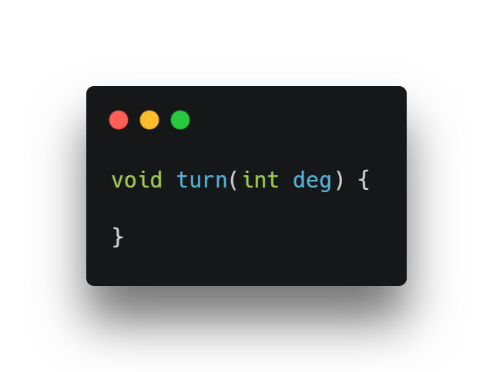
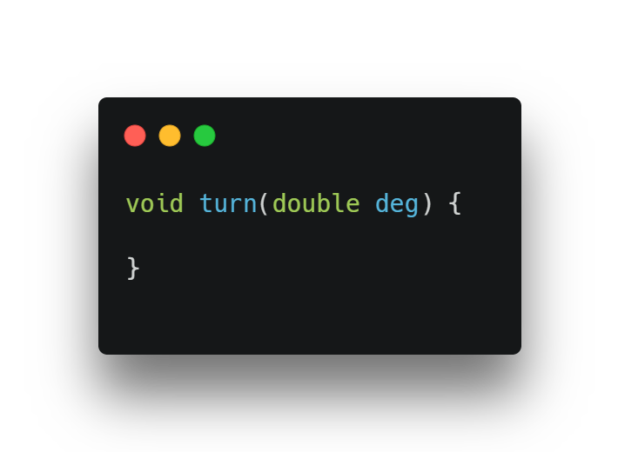
The Code Behind PID
Warmup: make an empty void function called “turn” that takes in an argument. The argument should be a number called “deg”.

Slide 18
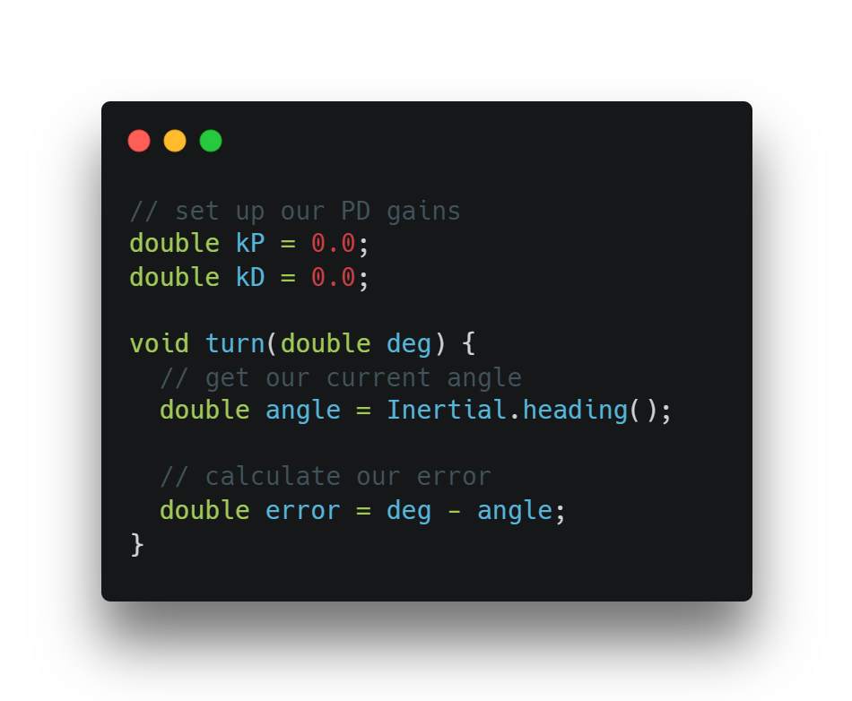
The Code - Setup
Now that we have our function, we can prepare for our code.
At the top, we have our gains. We’ll only be using a PD controller for this, since it’s simpler to create and is better in many cases. These gains are simply numbers we tune to get the most accurate movement from our robot.

Slide 19
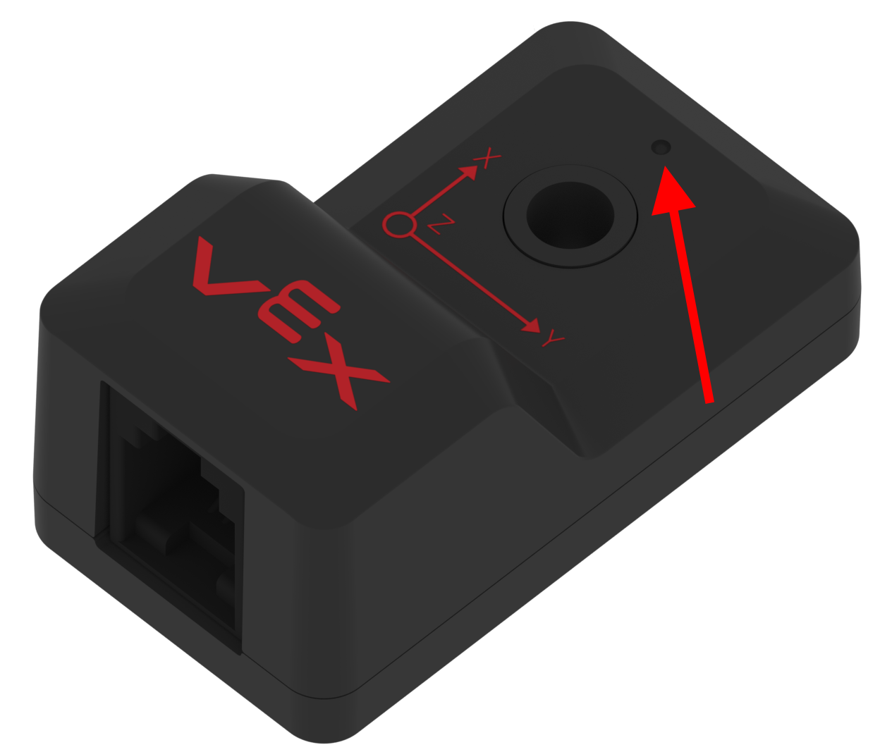
The Code - Setup
From there, we use something called an “Inertial” sensor to get the angle of our robot, aka the heading. An inertial sensor tells us some data about how fast we’re moving and where we’re facing. It’s locked with the earth, meaning it will always return an accurate value no matter how many times you try to trick it.

Slide 20
The Code - Setup
Next, we’ll simply calculate our error. Remember, error is the difference between where we are now and where we want to be in the future.
But WAIT… our angle is a number from 0 to 360, so if we typed something like “10” for deg and our current is 350, we will get a big negative number. Let’s fix this.

Slide 21
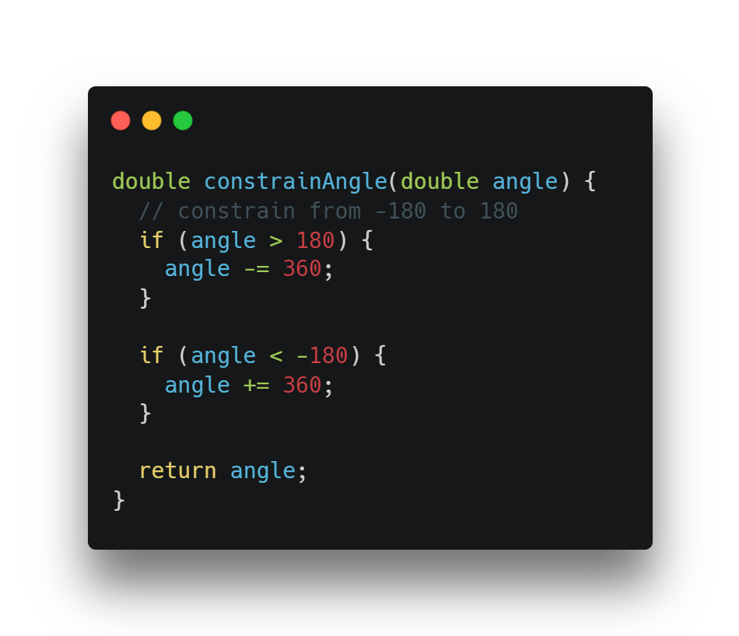
The Code – Angle Wrap
Above our turn function, let’s create this function. I’ll explain why we need it.
This does two things: it makes us take the shortest path to our goal angle, and it makes sure we get an angle from -180 to 180 when we calculate our error in our turn function.

Slide 22
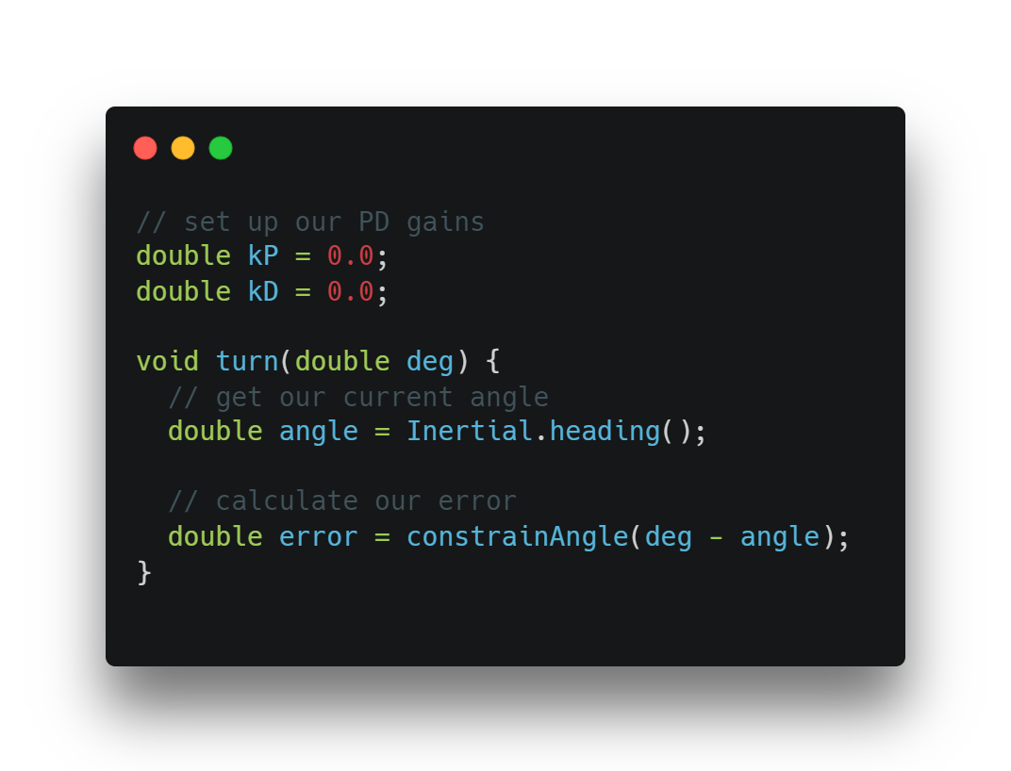
The Code – Angle Wrap
Let’s use our angle wrap!

Slide 23
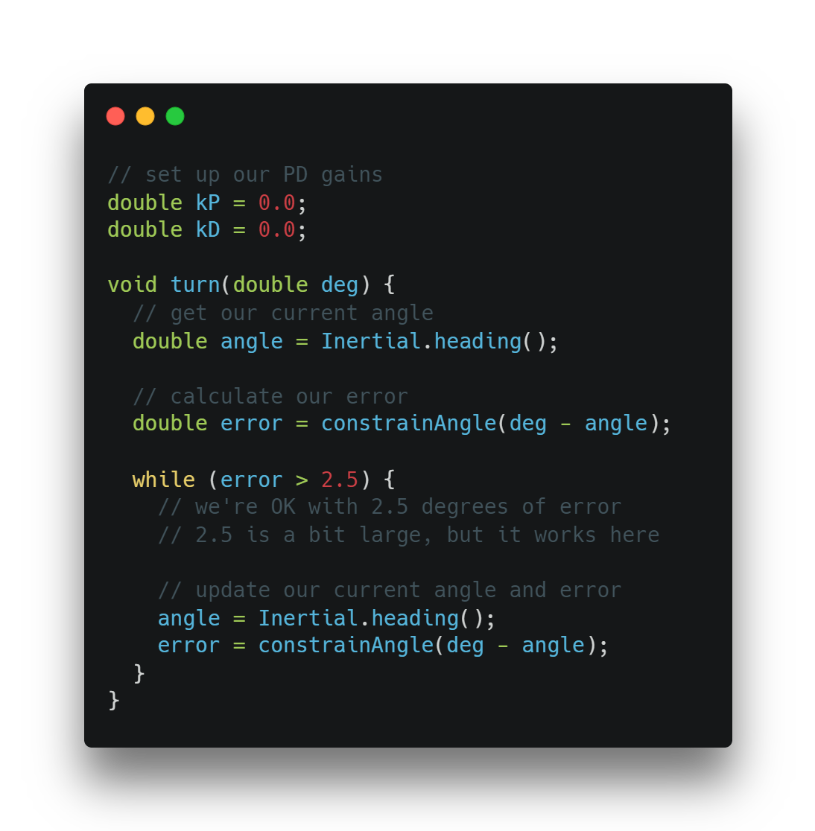
The Code – Calculating Error
The next step is creating our loop and updating our error! We’ll make a loop that exits when we get within 2.5 degrees of our target.
Inside our loop, all we have to do is update our error every time it runs! We simply get our new angle, then calculate our error again.

Slide 24
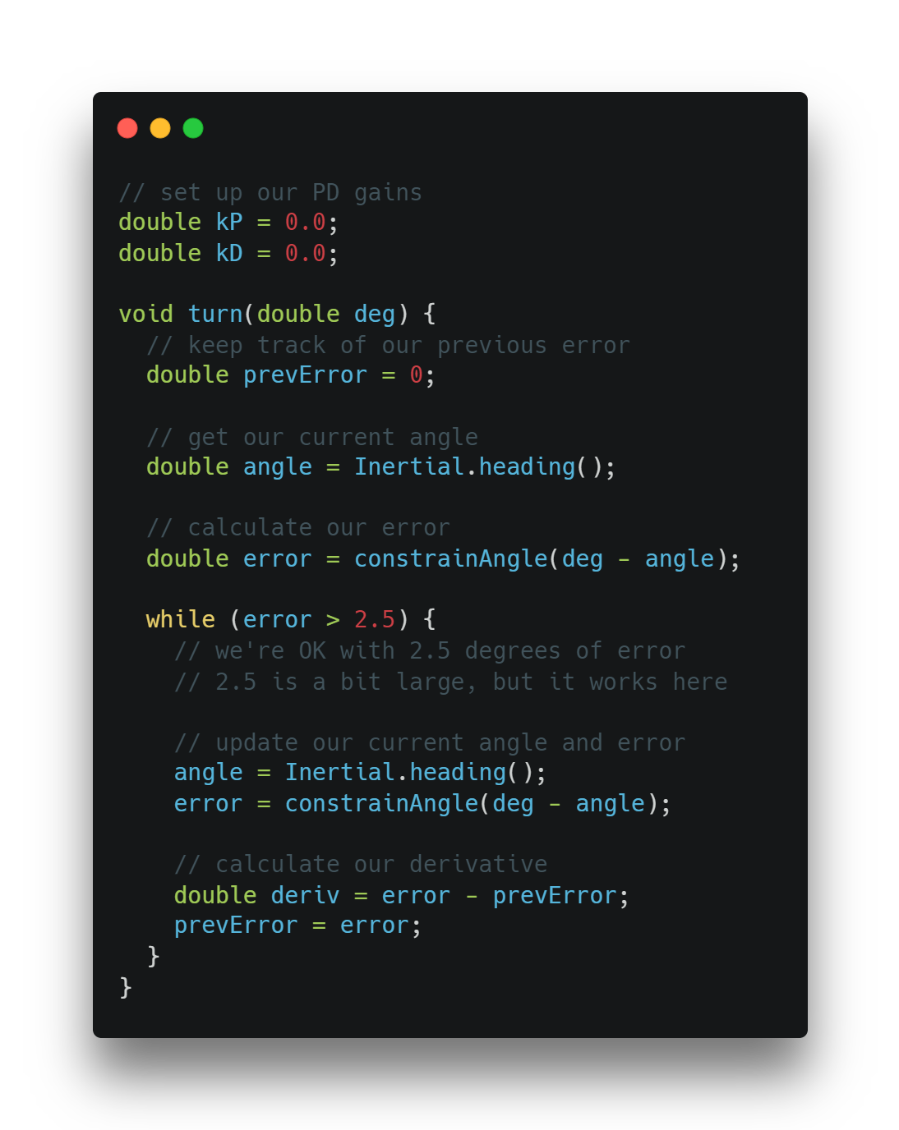
The Code – Derivative
Our “PD” controller has two letters, and we’re forgetting one! The “P” is proportional, which basically means it gets smaller as our error gets smaller.
The “D” is for derivative. Derivative is basically just the amount your error is changing, and it can be used to tell how fast you’re going (if it’s really big, it means your error is shrinking fast and you might want to slow down!). In order to track it, we must know our previous error.

Slide 25
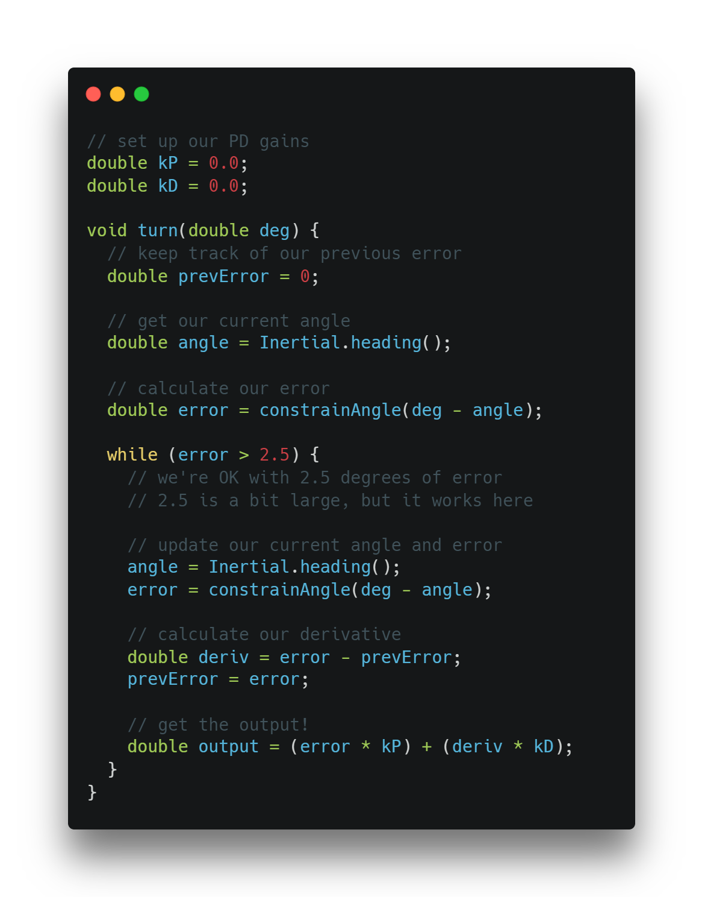
The Code – Getting The Output
Let’s find our output! The output is simply what we want to send to our motors in order to move the robot.
PID is special in that our constants help determine the output. Right now, the output will always be 0 since both kP and kD are 0, but changing those will change the output. This is how we tune the controller!

Slide 26
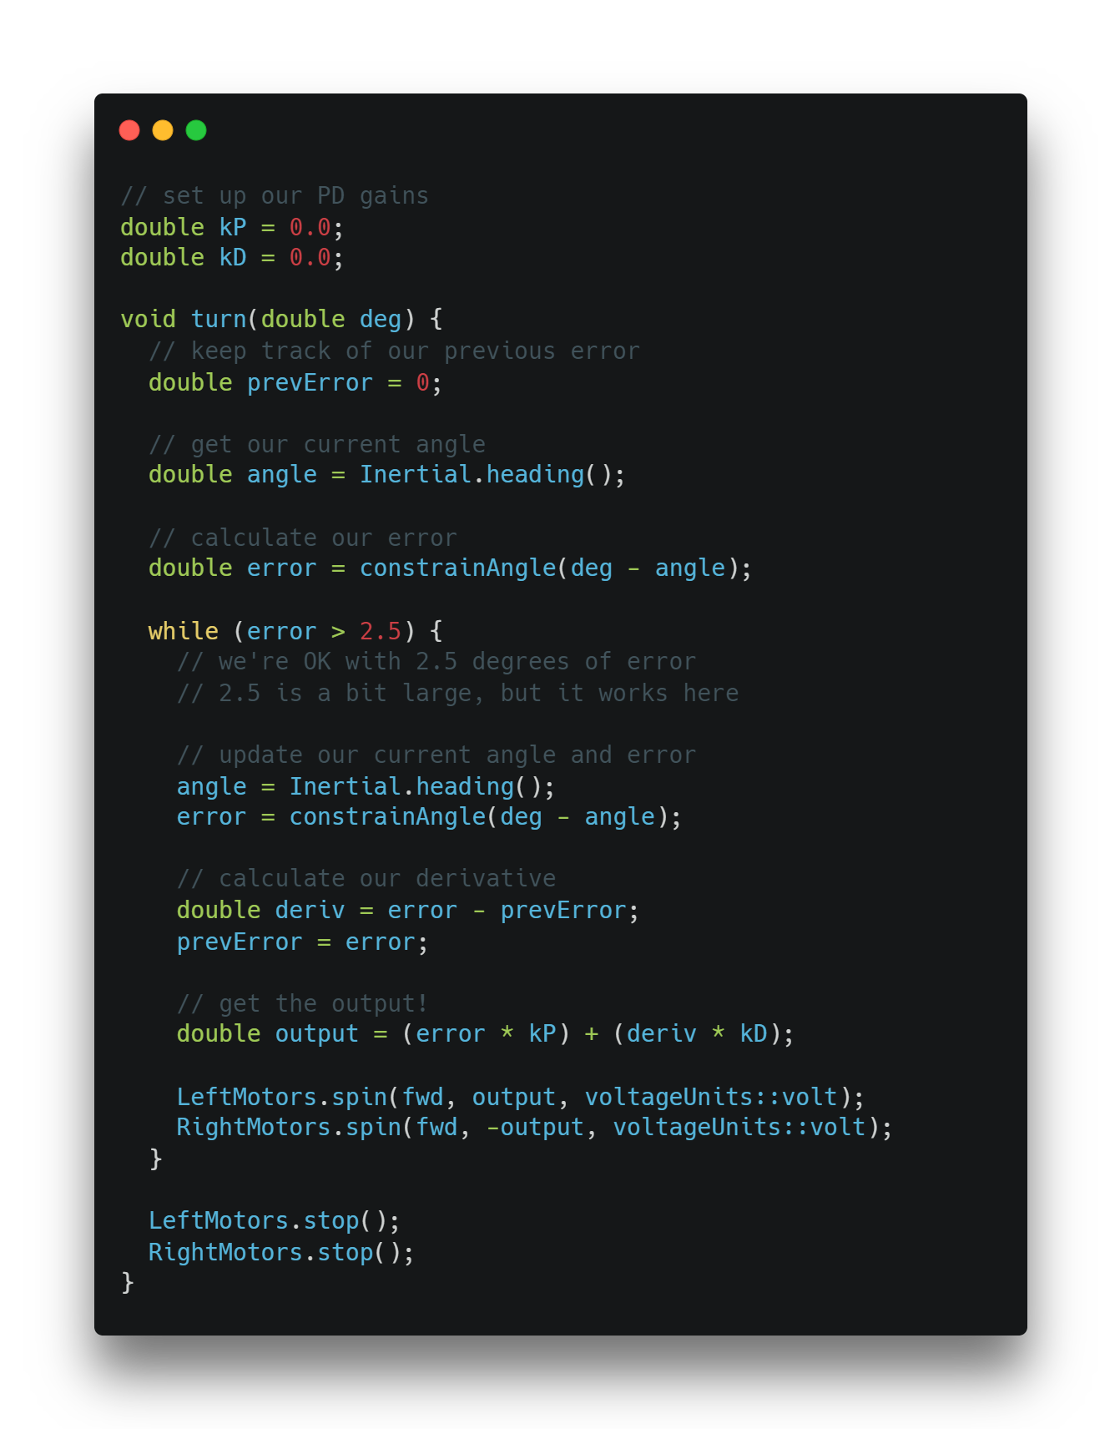
The Code – Moving
Finally (well, almost finally), we can move our motors.
Quiz: If we want to turn, our left motors must go _____ and our right motors must go ______.
We’ll apply the output in volts, since it will bypass the motor’s (somewhat bad) internal PID.

Slide 27
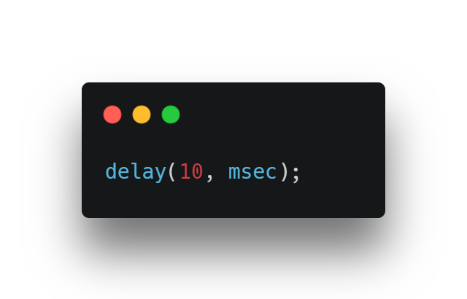
The Code – Moving
Last step! We should add a delay to the bottom of our loop, 10ms works fine.
Quiz: Why do we need a delay?

Slide 28
Your Turn
I’ll give everyone about 15 minutes, and your goal is to make the most accurate 90 degree turn possible by changing your PID constants. Winner gets candy (or other decent prize) tomorrow.

Slide 29
Recap
What type of controller is PID?
What does knowing our “derivative” tell us?
What does PID stand for?
Why do we need error tolerances?
Would this still work if we only had “P”. What about only “I” or “D”?

